Slide 1
Access Modifiers in constructor Parameters

Slide 2
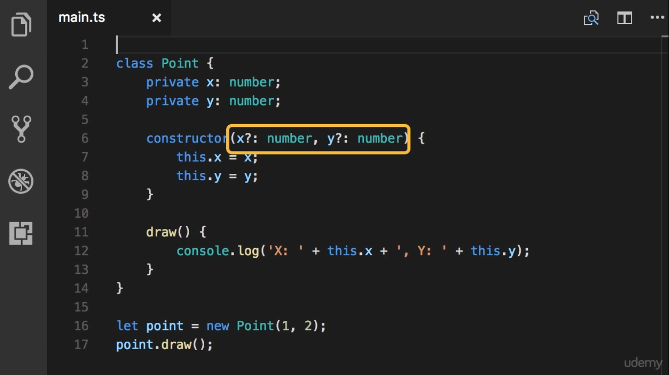

Slide 3
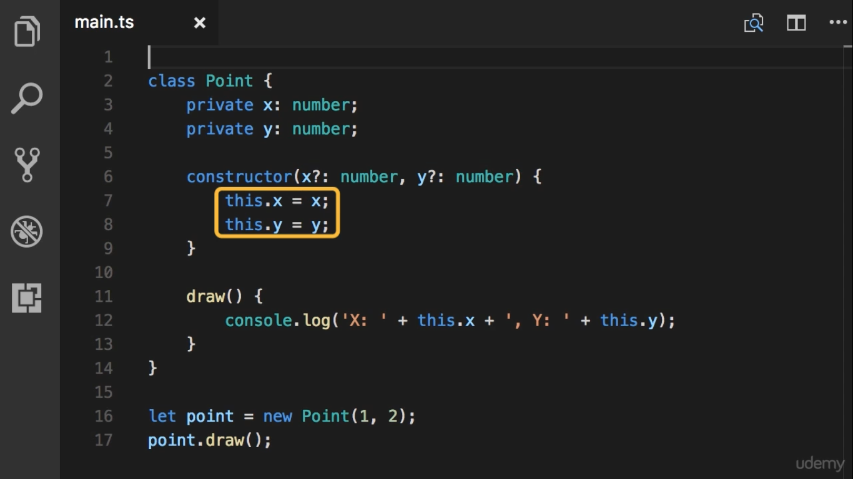

Slide 4
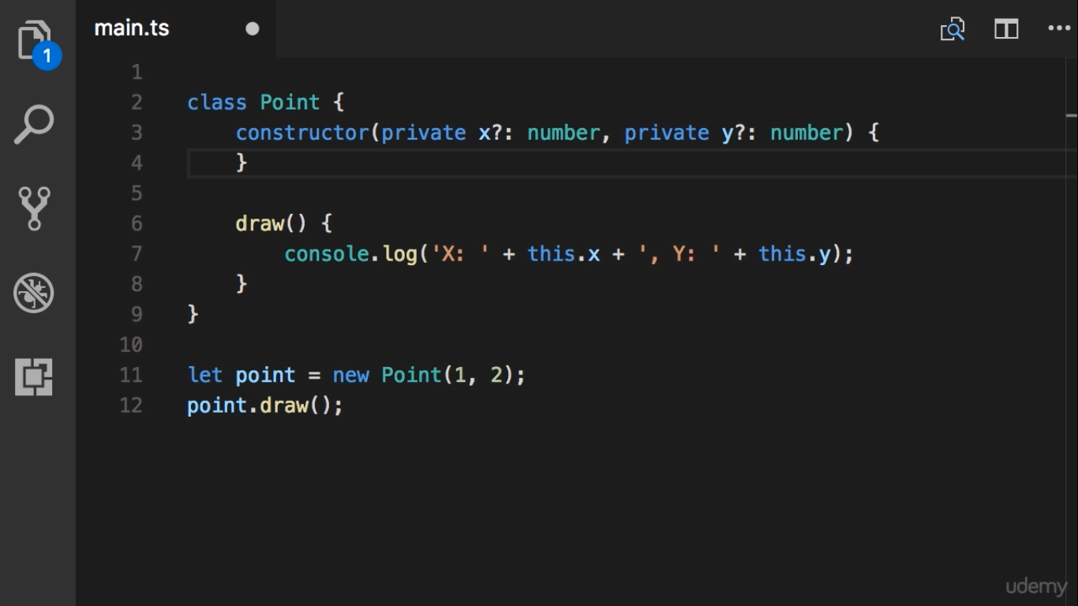

Slide 5
